Slide 1
2021-2022 Slate of Officers
Presented by Julie Rassmann
2nd Vice President

Slide 2
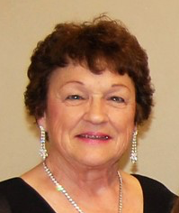
Jr Past President
Linda Gratteri
Chapter: Alpha Upsilon
Joined: November 2004
Chapter Offices Held: President, Vice President, Treasurer, Parliamentarian
District Offices Held: President, Vice President, Treasurer, Chaplain
State Offices Held: President, 1st Vice President, Treasurer, Workshop (I skipped 2nd Vice P. because I had to move up to 1st Vice P. almost immediately ... but you don't have to say that!!)
Appointed Chair Positions Held: Philanthropic Chair, Educational Chair
Attendance:
IC Conventions - 5 live and 1 ZOOM (!)
State Conventions - 11 live and 1 ZOOM
District Meetings - 3 (only 1 in 2020, and other 2 in 2019)

Slide 3
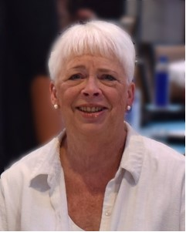
Corresponding Secretary
Donna Cassidy
Chapter: Delta Xi Joined Oct. 1969
Chapter Offices All offices multiple times
District Offices Held: President, VP, Secretary
State Offices Held:
Appointed Chair Positions Held: Assoc. of the Arts, Grapevine Editor, Outstanding Member
Attendance:
IC Conventions-
State Conventions –
District Mtgs in last two yrs – -

Slide 4
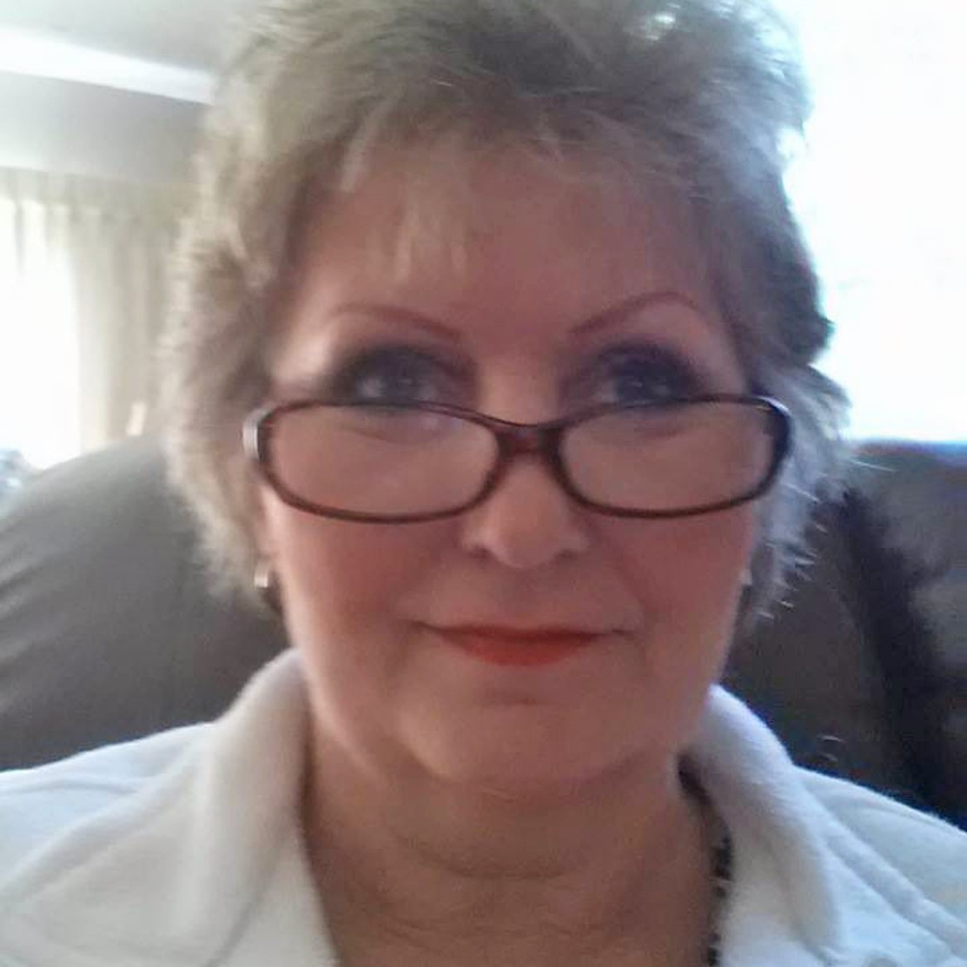
Workshop Coordinator
Tami Arthur
Chapter: Delta Kappa Joined May 2012
Chapter Offices: President & VP several times, Secretary, Treasurer, Education Director
District Offices Held: VP
State Offices Held:
Appointed Chair Positions Held: Hope for Heroes, Outstanding Member Chair
Attendance:
IC Conventions- 0
State Conventions – 7
District Mtgs in last two yrs – 4

Slide 5
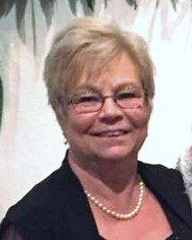
Workshop Coordinator
Jean Forsman
Chapter: Delta Gamma Joined Oct 1989
Chapter Offices
District Offices Held:
State Offices Held:
Appointed Chair Positions Held:
Attendance:
IC Conventions- yes
State Conventions – yes
District Mtgs in last two yrs – yes

Slide 6
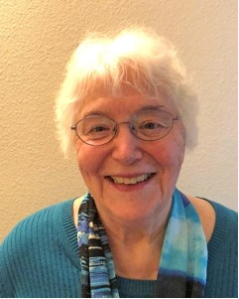
Treasurer
Jean Braden
Chapter: Delta Xi Joined June 1969
Chapter Offices Held: President, VP, Past President, Educational Dir. (twice), Corresponding Sec.
District Offices Held: NW District – Recording Sec., Treasurer
State Offices Held: None
Appointed Chair Positions Held: None
Attendance:
IC Conventions-
State Conventions – 6
District Mtgs in last two yrs – 6

Slide 7
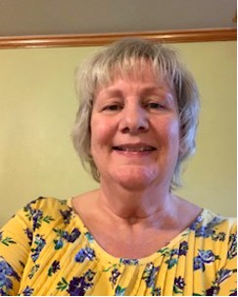
Treasurer
Penny Phelps
Chapter: Delta Kappa Joined June 1983
Chapter Offices President, VP, Secretary, Treasurer, Educational Director
District Offices Held:
State Offices Held:
Appointed Chair Positions Held:
Attendance:
IC Conventions-
State Conventions – 22
District Mtgs in last two yrs – 1

Slide 8
Recording Secretary
Joyce Hodge
Chapter: Alpha Psi Joined Jan 1978
Chapter Offices All offices
District Offices Held:
State Offices Held: Recording Sec, Treasurer
Appointed Chair Positions Held: Parliamentarian, Audit, Philanthropic
Attendance:
IC Conventions-
State Conventions – 31
District Mtgs in last two yrs – 6+-

Slide 9
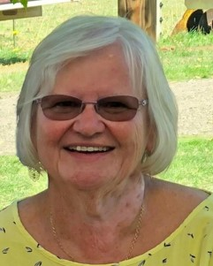
2nd Vice President
Connie Russell
Chapter: Beta Eta Joined Oct. 2012
Chapter Offices President, VP, Secretary
District Offices Held: President, VP
State Offices Held: Treasurer
Appointed Chair Positions Held: Winter Mtg Chair, Easter Seals Chair, St. Jude Jr. & Sr. chair
Attendance:
IC Conventions- two
State Conventions – 7
District Mtgs in last two yrs – 6

Slide 10
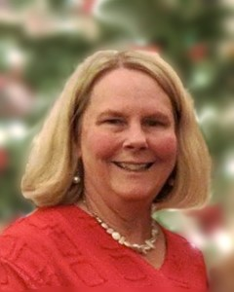
1st Vice President
Julie Rassmann
Chapter: Delta Gamma
Joined June 1996
Chapter Offices All offices, except treasurer, multiple times
District Offices Held: President, VP, Secretary, Publicity
State Offices Held: 2nd VP, Recording Sec, Workshop, Parliamentarian (at the time this was an elected position).
Appointed Chair Positions Held: Assoc. of the Arts, Grapevine Editor, Outstanding Member
Attendance:
IC Conventions- three
State Conventions – 19+-
District Mtgs in last two yrs – 4+-

Slide 11
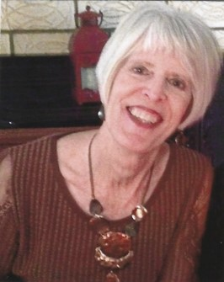
President
Debbie Sanguras
Chapter: Delta Kappa
Joined June 1979
Chapter Offices Held: All offices, except treasurer, multiple times
District Offices Held: VP, Secretary, Audit, St. Jude, Easter Seal & Scholarship chairs
State Offices Held: Rec. Sec., Treasurer, Workshop Chair, 2nd VP, 1st VP
Appointed Chair Positions Held: Leadership, Asso. Of the Arts, Awards, Chaplain, Easter Seals, Educational, Philanthropic, Outstanding Member, and Publicity
Attendance:
IC Conventions- three
State Conventions – 36
District Mtgs in last two yrs – six

